Slide 1
IoT based Milk Quality Analysis System for Fat and Protein Detection
Advisor: Dr. Mansoor Ali Khan
Co-Advisor: Dr. Nasir Mehmood
Ch. Muhammad Shaheer Yasir (286021) (BEE 11B)
Nihal Ahmad (303249) (BEE 11B)
Muhammad Hamza Khalid (298694) (BEE 11B)

Slide 2
Contents
Introduction
Problem Statement
Literature review
Objectives
Our Method
Implementation
Results
Demonstration Video
Conclusion
FYDP Deliverables Upload Status

Slide 3
Introduction
Pakistan’s economy is highly depended on the agriculture and dairy industry.
One of the major problems that the consumers face is the adulteration of pure milk with water, detergents and other harmful substances.
We propose a solution to measure the quality of milk through attenuation of light waves as they pass through a milk sample.
First, we identify the most important milk parameters and the techniques used to identify them. Then we discuss the effectiveness of each technique against the parameters.
Then we choose the spectrophotometric technique to measure milk quality. We gathered data from different milk samples containing varying amounts of fats and proteins. Then we build a PLS regression model to predict the fat and protein content.
Finally, we build a small Raspberry Pi based device to predict fat content. This device consists of an LDR which measures the absorption of light passing through milk samples. This model is also able to predict fat content in a milk sample effectively.

Slide 4
Problem Statement
The WHO stated that Pakistan produces 140 million liters of milk annually, while 500 million liters is sold.
Drinking contaminated milk can lead to a number of health complications including indigestion, vomiting, diabetes and kidney issues.
Our project aims to reduce the practice of milk adulteration by providing an affordable and easy to use solution which can be used by anyone, anywhere.
While there are devices like that to measure milk quality, however none of them are present in our local markets. They are primarily marketed towards the industries and labs rather than the consumer and are very expensive.
To gauge the customer interest, we created a google form and circulated it on different social media platforms. Out of the 45 responses received, 85% of people were willing to buy such a device to check the quality of milk they consume.

Slide 5
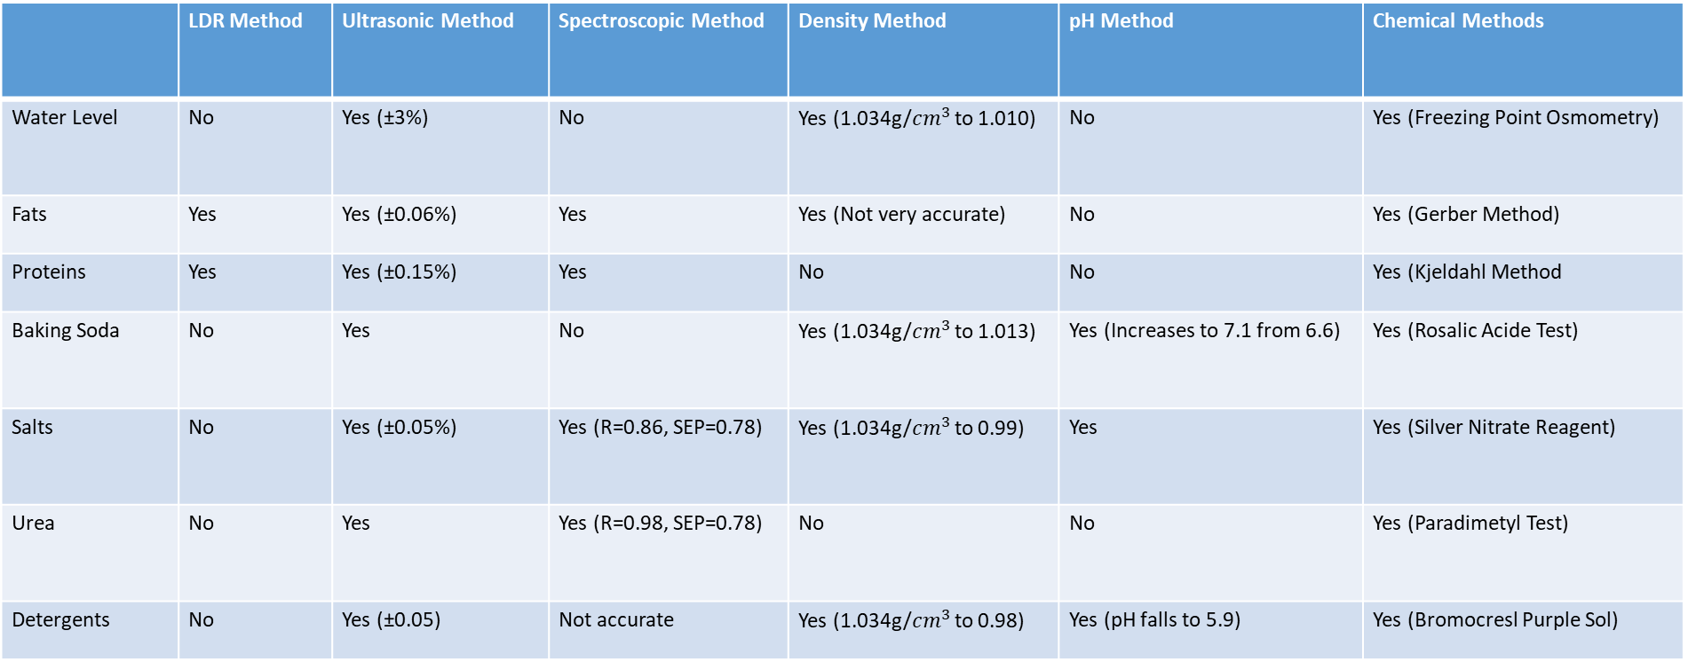
Literature review
 | LDR Method | Ultrasonic Method | Spectroscopic Method | Density Method | pH Method | Chemical Methods
Water Level | No | Yes (±3%) | No | Yes (1.034g/${cm}^{3}$ to 1.010) | No | Yes (Freezing Point Osmometry)
Fats | Yes | Yes (±0.06%) | Yes | Yes (Not very accurate) | No | Yes (Gerber Method)
Proteins | Yes | Yes (±0.15%) | Yes | No | No | Yes (Kjeldahl Method
Baking Soda | No | Yes | No | Yes (1.034g/${cm}^{3}$ to 1.013) | Yes (Increases to 7.1 from 6.6) | Yes (Rosalic Acide Test)
Salts | No | Yes (±0.05%) | Yes (R=0.86, SEP=0.78) | Yes (1.034g/${cm}^{3}$ to 0.99) | Yes | Yes (Silver Nitrate Reagent)
Urea | No | Yes | Yes (R=0.98, SEP=0.78) | No | No | Yes (Paradimetyl Test)
Detergents | No | Yes (±0.05) | Not accurate | Yes (1.034g/${cm}^{3}$ to 0.98) | Yes (pH falls to 5.9) | Yes (Bromocresl Purple Sol)

Slide 6
Objectives
To highlight different methods that can potentially be used to check for different milk parameters.
Develop an embedded device that can accurately measure the quality of milk, including its fat content, protein content, and other relevant parameters.
Design a user-friendly interface for the embedded device, allowing dairy farmers and other users to easily input data and receive information on milk quality.
Incorporate machine learning algorithms into the embedded device, enabling it to detect and flag adulterated or low-quality milk.

Slide 7
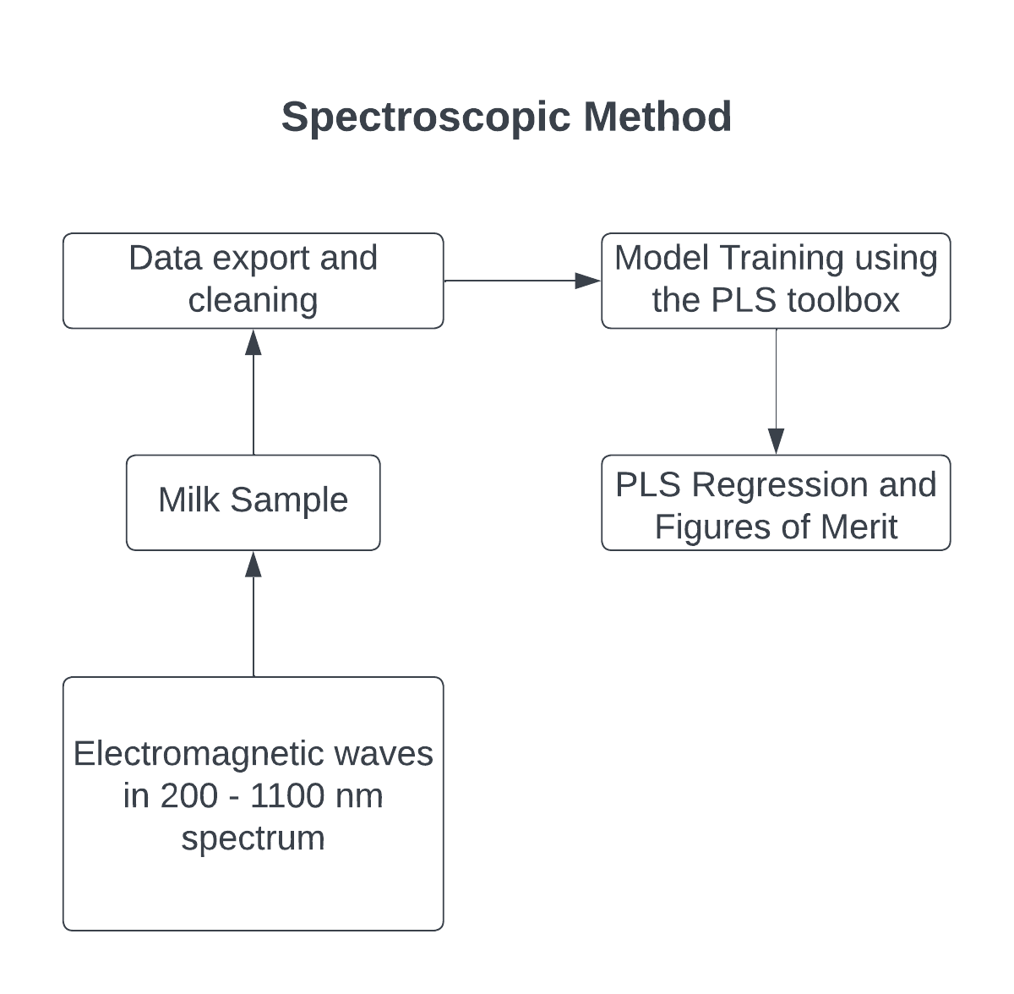
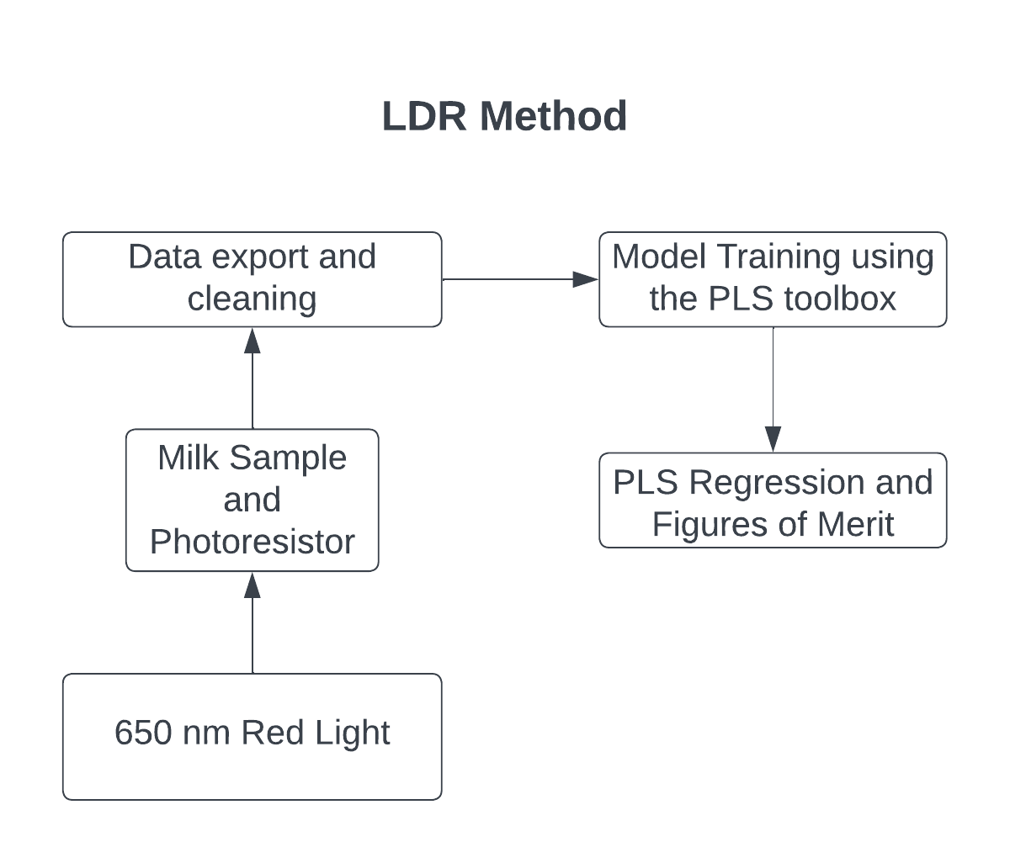
Our Method

Slide 8
Implementation of Spectroscopic Method
Optical spectroscopy involves the use of light absorption through milk to measure certain parameters.
We have used the spectrum of 200 – 1100 nm. This spectrum includes UV, VIS and NIR Spectra.
To collect the data for the model, we had 36 samples for the proteins and 36 samples for fats.
The fat and protein contents of the samples were 0.9, 1.7 and 3.5g for fats and 2.2, 2.7 and 3.2g for proteins.
The readings were taken on the spectrophotometer available in the Industrial Bio Tech Lab in ASAB.
First, we fill two test tubes with distilled water and take a blank reading. Then one of the test tubes is emptied and the sample is poured in. The light absorption in the distilled water is used as the reference reading.
Before taking the next reading, the test tubes were emptied and rinsed. This process was then repeated for all other samples.
The data was then exported to a csv file. Then we made a python script to divide the data into two vectors: the absorption values and the wavelengths.
This was then plotted in MATLAB and converted to test and train data using the Kennard Stone algorithm.
PCA Score Analysis was carried out on smoothed data of absorption readings of fat and protein content.
Finally, we applied PLS regression with 8 latent variables for fat content and 5 latent variables for protein content.

Slide 9
Implementation of LDR Method
Here we use a HW-483 LED that emits red light at a wavelength of 650nm.
The light falls on an LDR connected to a capacitor.
The resistance of the LDR decreases with an increase in light intensity. By measuring the time, it takes to charge the capacitor, we can measure the LDR resistance and thus measure the amount of light passing through our milk sample.
The longer it takes to charge the capacitor, the higher the resistance of the LDR.
The samples we used had fat content of 0.9, 1.7 and 3.5g.
The same method is used to treat the raw values from the LDR as discussed previously.
A single latent variable is selected to train the PLS regression model.

Slide 10
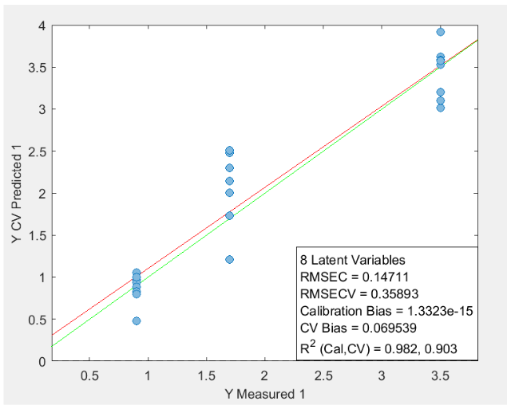
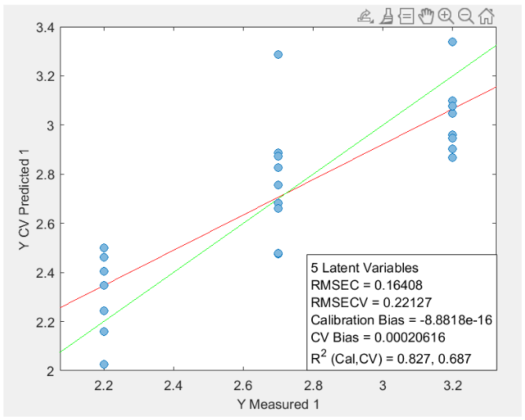
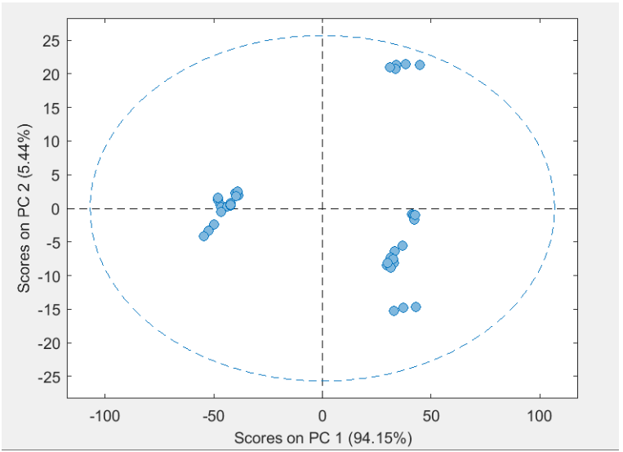
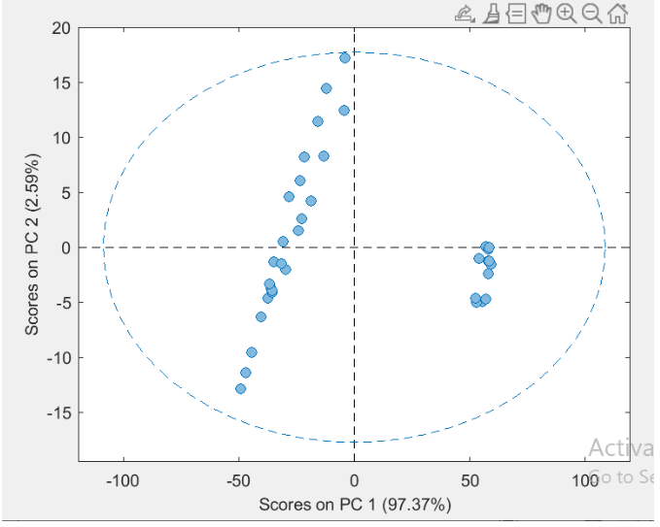
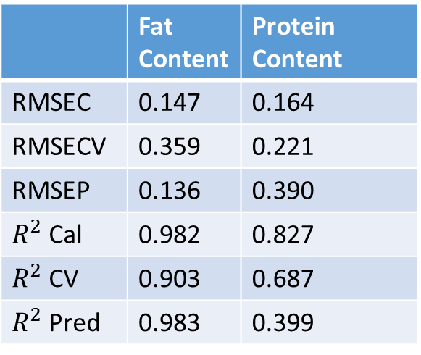
Results of Spectroscopic Method
 | Fat Content | Protein Content
RMSEC | 0.147 | 0.164
RMSECV | 0.359 | 0.221
RMSEP | 0.136 | 0.390
$R^{2}$ Cal | 0.982 | 0.827
$R^{2}$ CV | 0.903 | 0.687
$R^{2}$ Pred | 0.983 | 0.399
PLS Model for Protein prediction
PLS Model for Fat prediction
PCA Analysis on Fat content
PCA Analysis on Protein content

Slide 11
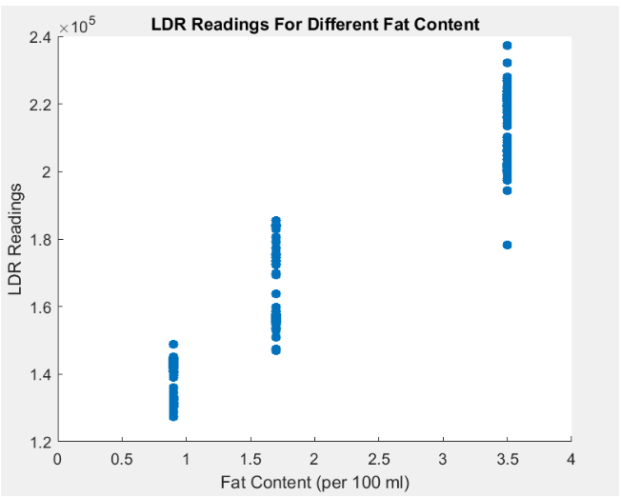
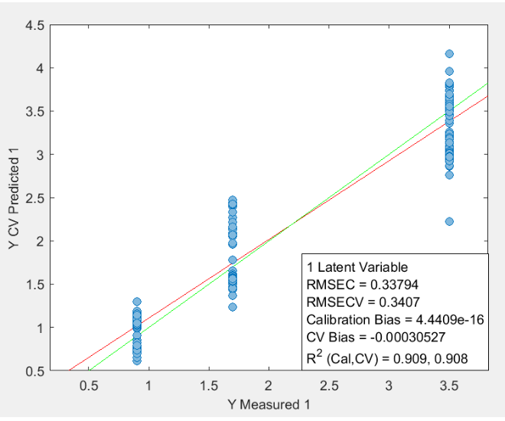
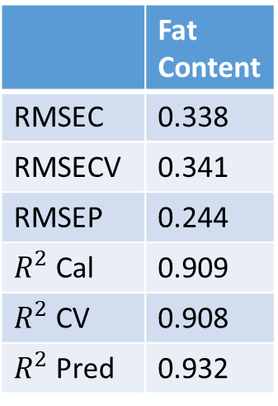
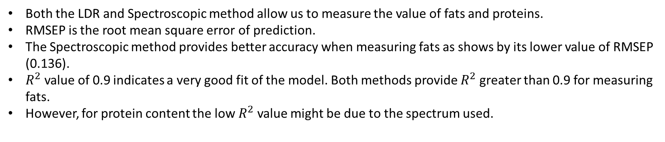
Results of LDR Method
 | Fat Content
RMSEC | 0.338
RMSECV | 0.341
RMSEP | 0.244
$R^{2}$ Cal | 0.909
$R^{2}$ CV | 0.908
$R^{2}$ Pred | 0.932
Scatter Plot of LDR readings
PLS Model for Fat prediction
Both the LDR and Spectroscopic method allow us to measure the value of fats and proteins.
RMSEP is the root mean square error of prediction.
The Spectroscopic method provides better accuracy when measuring fats as shows by its lower value of RMSEP (0.136).
$R^{2}$ value of 0.9 indicates a very good fit of the model. Both methods provide $R^{2}$ greater than 0.9 for measuring fats.
However, for protein content the low $R^{2}$ value might be due to the spectrum used.

Slide 12
Conclusion
Throughout this project we explored different methods that could potentially be used to measure different components of milk.
The two main components of interest are Fats and Proteins; and the two methods of interest are the LDR method and the Spectroscopic method.
Both the LDR and Spectroscopic methods are viable routes to measure Fat concentration in milk samples.
Spectroscopy can also be used to measured to protein content, though the model developed needs a bit more refinements.
Other spectrums (such as MIR) can also be used to see if they respond to changes in proteins more effectively.

Slide 13
FYDP Deliverables Upload Status (PMS)
Sr. | FYDP Deliverable | Status
1 | Final report | Yes
2 | Final presentation slides | Yes
3 | Poster (A1 size) | Yes
4 | Plagiarism report | Yes
5 | Demo Video | Yes

Slide 14
THANK YOU

